Slide 1
How High School Graduation Impacts American Lives
Meena Meyyappan, Molly Sunray, Adina Palayoor, Megan Sin

Slide 2
WHAT QUESTION ARE WE TRYING TO ANSWER?
How did the high school graduation rate in a particular state affect factors within that state such as illiteracy, income, murder and life expectancy in 1977?
Ex. Does a lower graduation rate imply lower income or higher murder rates?
Notes:
After looking at the data, we came up with the question: how does the hs graduation rate in a particular state affect variables like illiteracy, income, murder, or life expectancy?
All of these factors have the potential to be related, for example, does a lower graduation rate imply a lower income, or a higher murder rate?

Slide 3
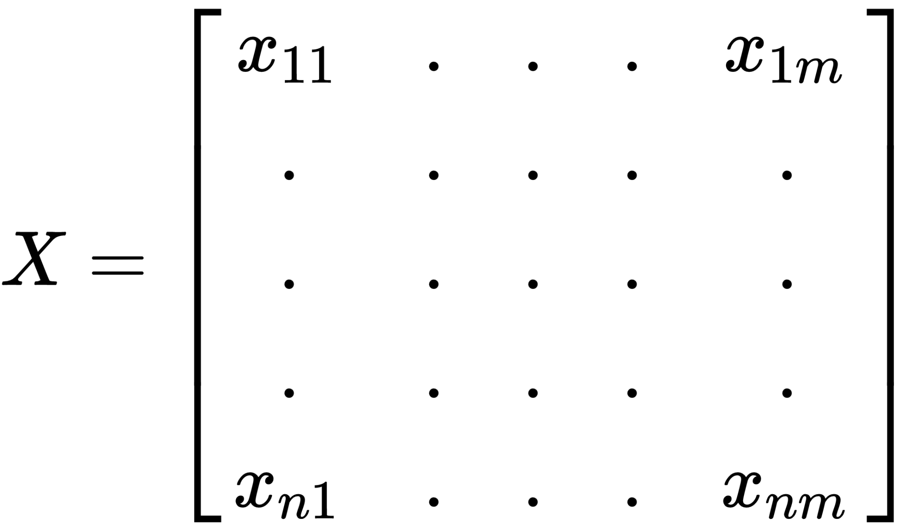

WHAT DATA ARE WE EXPLORING?
state.x77
Size
8 Variables
Dataset included in R
(state.x77)
50 rows and 8 columns
Population, Income, Illiteracy, LifeExp, Murder, HSGrad, Frost, Area
Source: U.S. Department of Commerce, Bureau of the Census (1977) Statistical Abstract of the United States, and U.S. Department of Commerce, Bureau of the Census (1977) County and City Data Book.
Notes:
We chose a data set provided by R, called state.x77. It has 50 rows, one respective to each state, and 8 columns that are part of 8 variables.
List vars
This data is directly from the US dept of commerce from 1977

Slide 4
Splitting Up the Data
50 rows of data
Randomly chose 70% to be training data
Everything else used as testing data
R Code:
?state.x77
smp_siz = floor(0.70*nrow(state.x77))
set.seed(123)
train_ind = sample(seq_len(nrow(state.x77)), size = smp_siz)
train =state.x77[train_ind,]
test=state.x77[-train_ind,]

Slide 5
Note
We eliminated analysis of the relationship High School Graduation Rates has on Frost and Area as those relationships are illogical.
However, vice versa, the possible relationship of Frost and Area on High School Graduation Rates can be examined in the future.
Notes:
We didn’t analyze the relationship between hs graduation rates and other given variables such as frost or area since they’re don’t add much valuable information to
The type of analysis we were going for, but these variables could definitely be looked at in the future for different reasons.

Slide 6
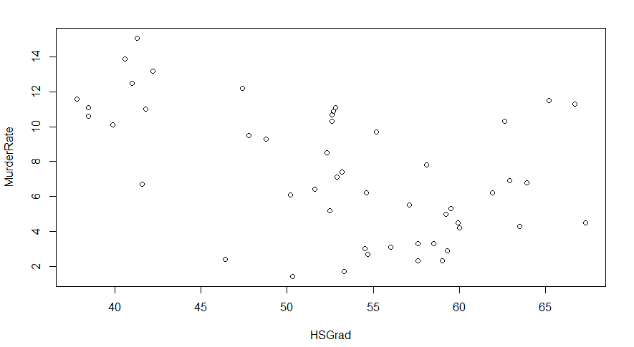
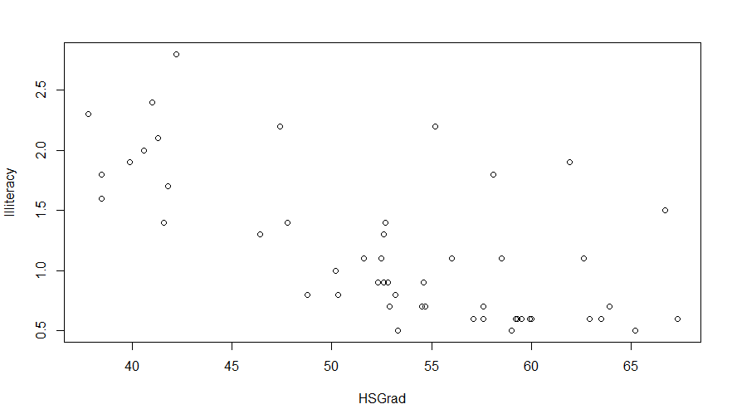
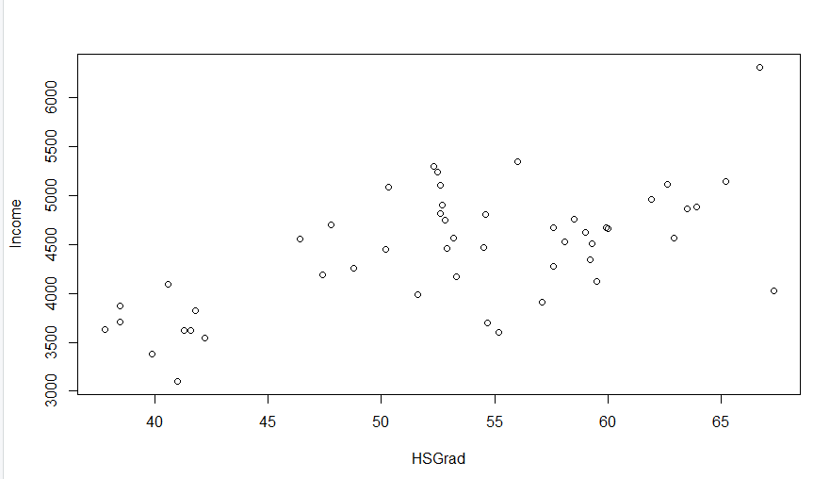
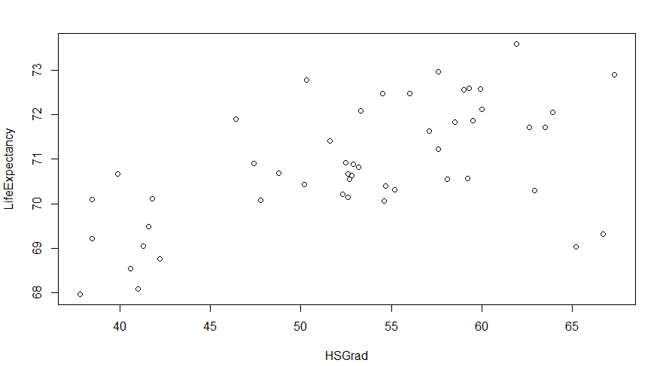
Think about general trends of the graphs:
Positive?
Negative?
Linear?
Polynomial?
Trends of Individual Variables
3 graphs comparing high graduation rate with:
Murder / 100,000 people
Income
Life Expectancy
Illiteracy rate percentage
HS Grad compared to:
Murder Rate: Negative or Polynomial trend, fluctuates throughout the interval
Income: Positive linear trend
Life Expectancy: Positive linear trend
Illiteracy: Negative linear trend
Notes:
Here we’ve related hs grad with 4 out of the 8 variables: murder, income, life expectancy, and illteracy rate. While looking at these graphs, it’s helpful to think about general trends. Are they positive? Negative? Linear or polynomial?
Murder rates compared to hs graduation can be seen both as polynomial or as negative, as it fluctuates throughout the interval. Income and life expectancy as a positive linear trend, but illiteracy has a negative linear trend

Slide 7
Notes:
Here you can easily see the trends in these graphs by following the arrows:

Slide 8
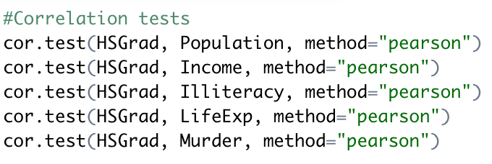
Correlation Testing
Relationship (x, y) | P-value | Correlation Coefficient
HSGrad, Population | 0.8093 | -0.04230587
HSGrad, Income | 1.422e-05 | 0.6630467
HSGrad, Illiteracy | 1.846e-05 | -0.6565166
HSGrad, LifeExp | 7.73e-05 | 0.617608
HSGrad, Murder | 0.000576 | -0.5526576
Notes:
Megan
Looking at the p-values of from the correlation tests, there seems to be correlation between HSGrad rate and Income, Illiteracy, LifeExpectancy, and Murder as their p-values are all less than 1%. However, the results from the HSGraduation rate and Population correlation test show a large p-value of 0.8093 which is well above the 1% alpha level.

Slide 9
Overview
Approaches
Linear Regression
Polynomial Regression
Linear Regression with Interaction Terms
Notes:
megan

Slide 10
01
Linear Regression

Slide 11
PROCESS
Determine which variables might have linear relationships
Compute testing error
1
2
3
Create linear models
Notes:
The process for performing linear regression included determining which variables have linear relationships, which was mentioned earlier, creating linear models using the training data, and lastly using the testing data to compute the error.

Slide 12
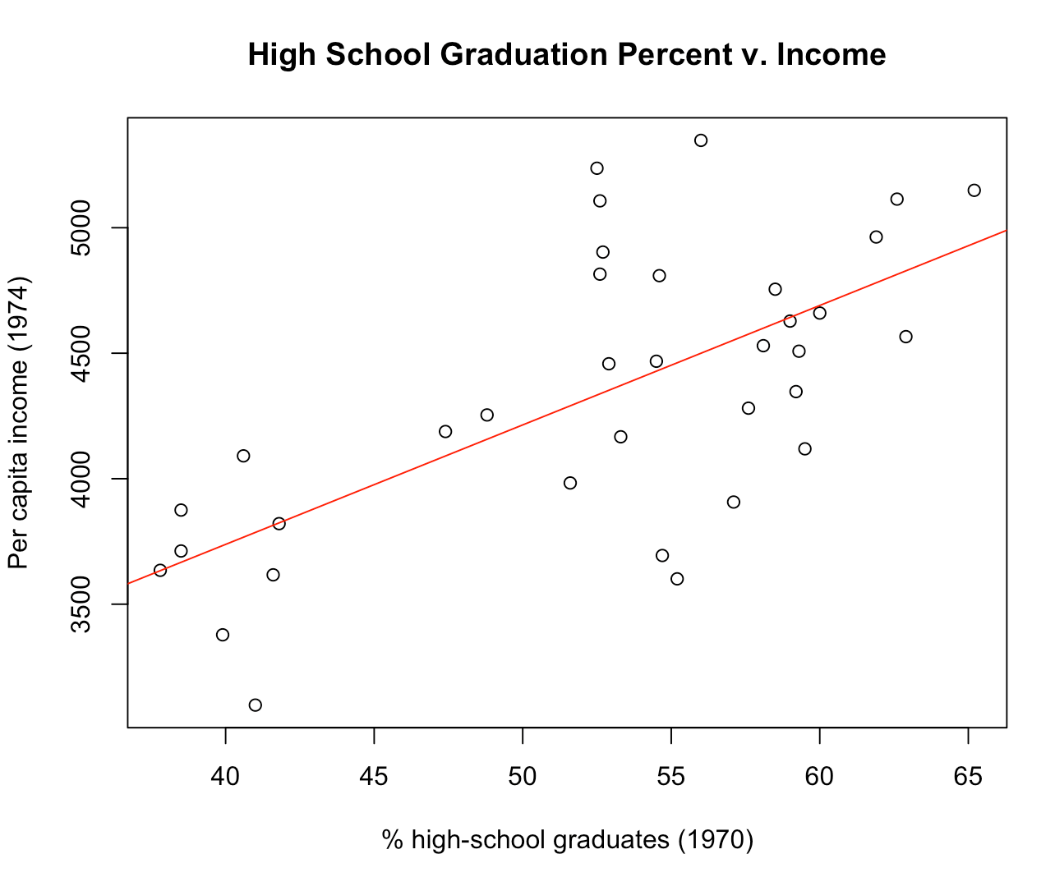
Models Generated
*Data points in graph are from training data set
Notes:
The first variable we analyzed was income. The linear fit for the data shows a positive trend.

Slide 13
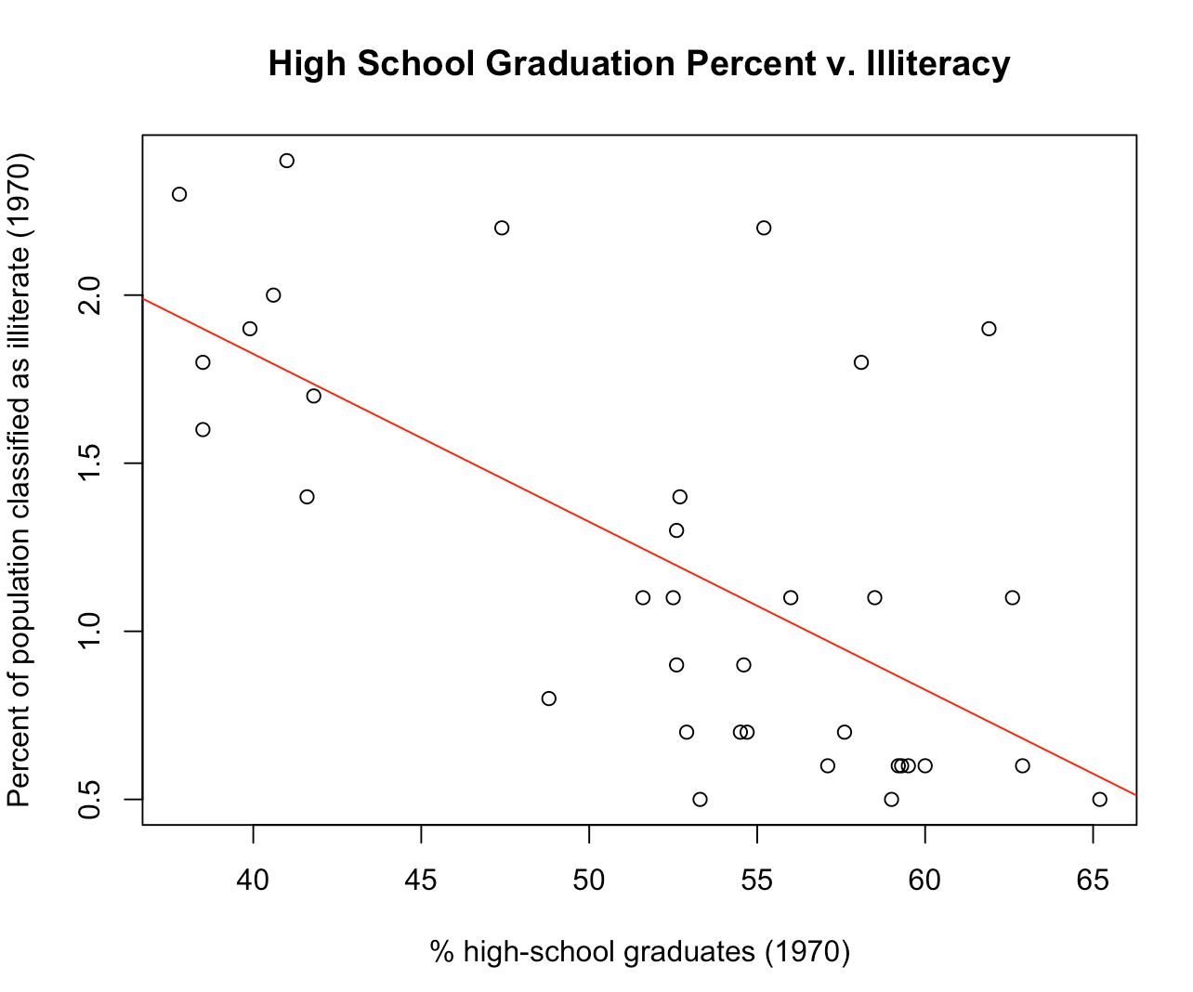
Models Generated
*Data points in graph are from training data set
Notes:
The next variable we analyzed was illiteracy. The linear fit for the data shows a negative trend.

Slide 14
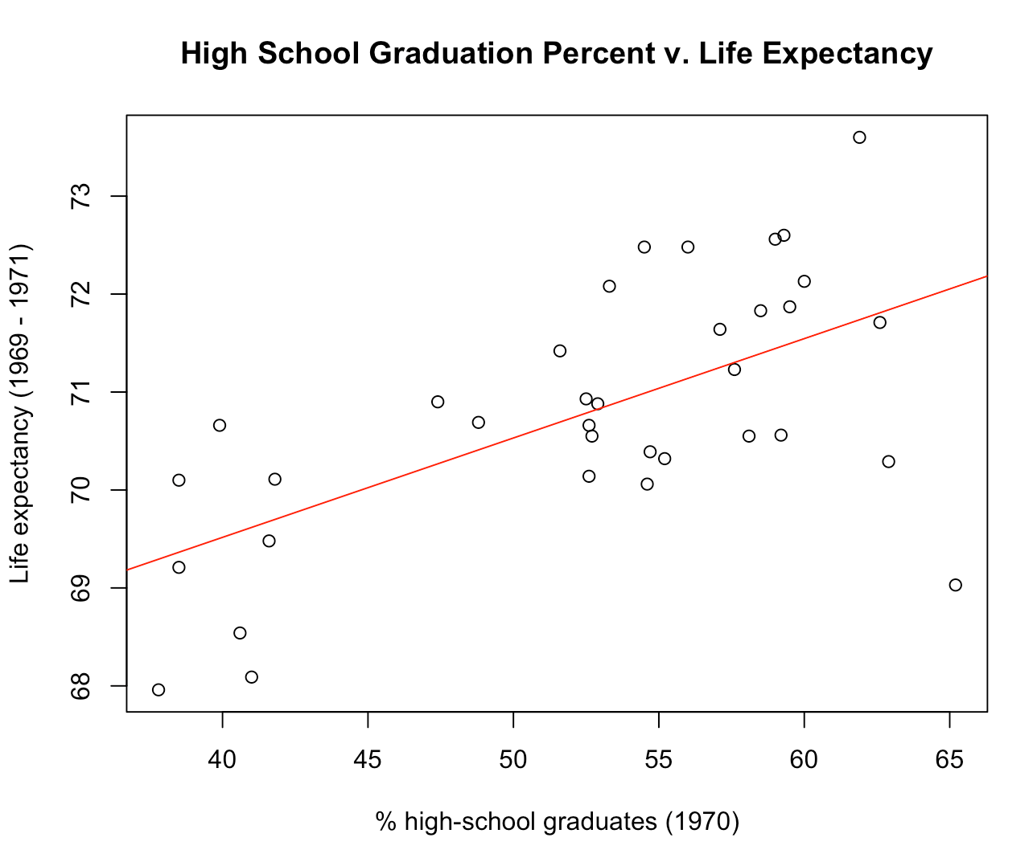
Models Generated
*Data points in graph are from training data set
Notes:
We also analyzed life expectancy and the data was fit along a positive trend.

Slide 15
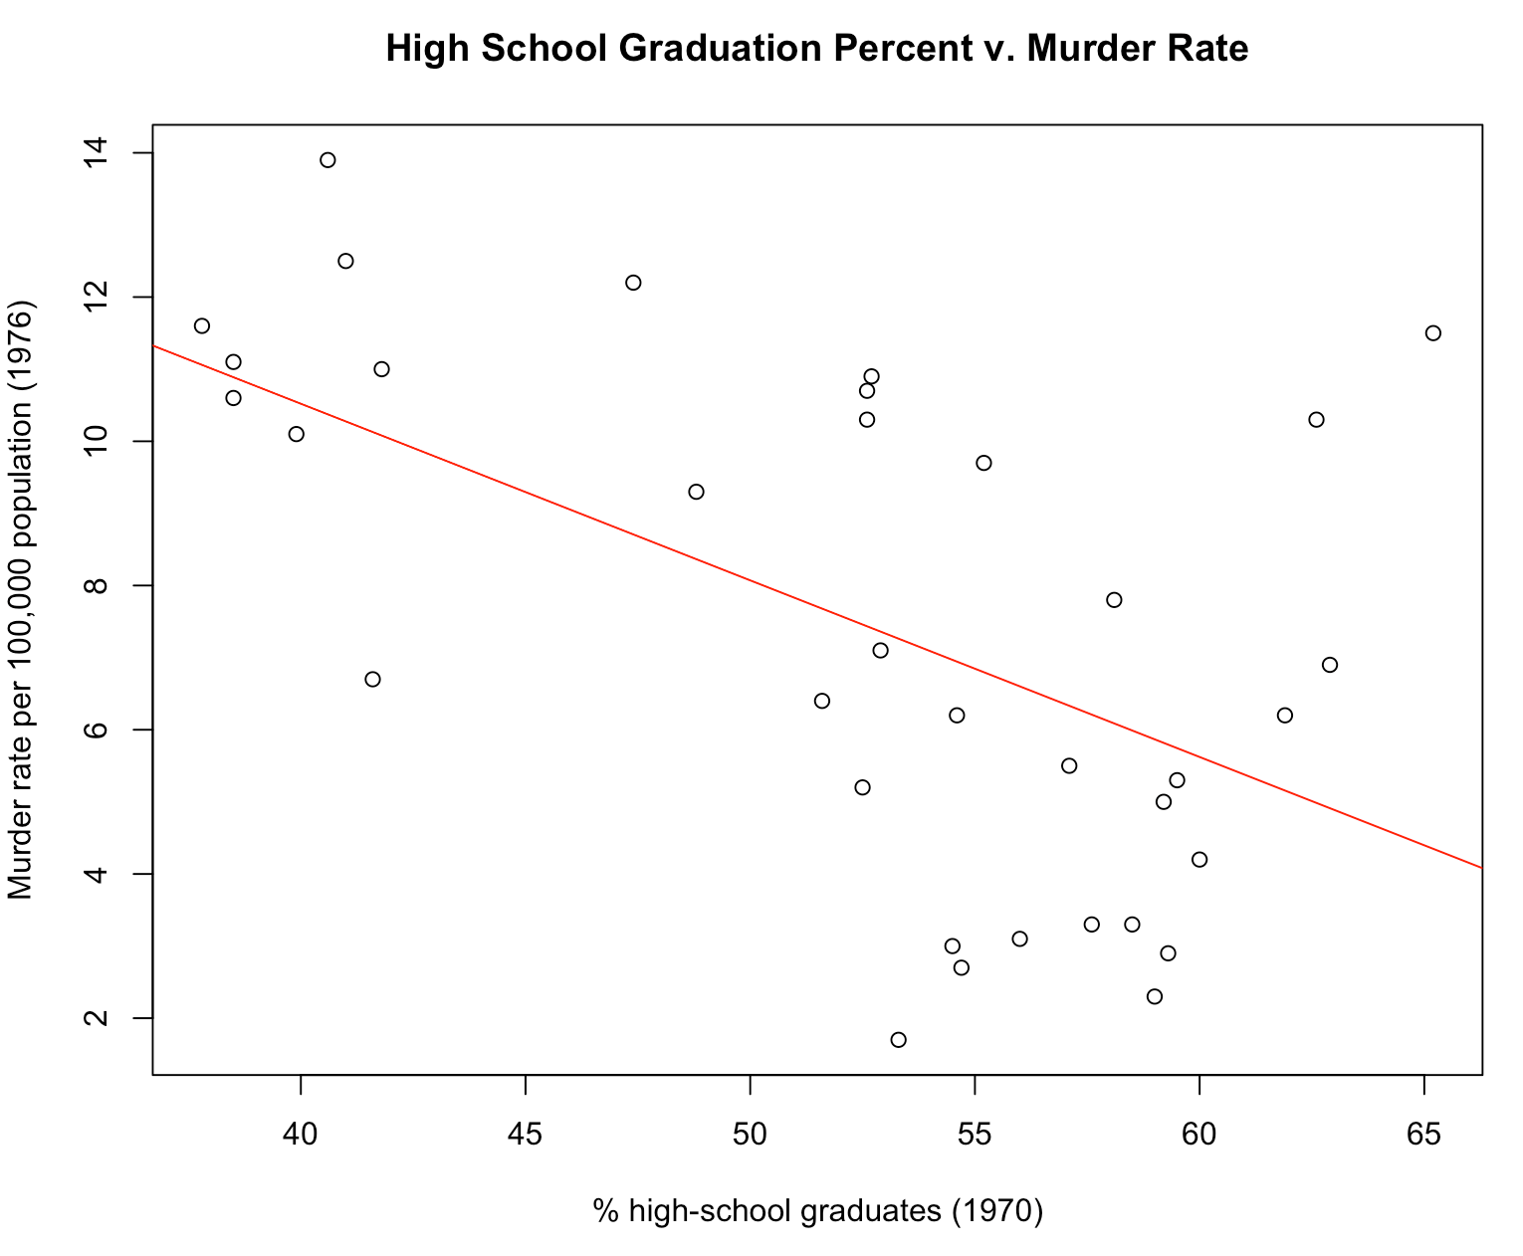
Models Generated
*Data points in graph are from training data set
Notes:
Lastly, we analyzed murder rate and saw a negative trend.

Slide 16
02
Polynomial Regression
Notes:
megan

Slide 17
PROCESS
Look at scatterplots of HSGrad v. all other variables and look for possible polynomial trends
Compute testing error
1
2
3
Create polynomial models up to the power of 6 and compare p-values in ANOVA Table
Notes:
megan

Slide 18
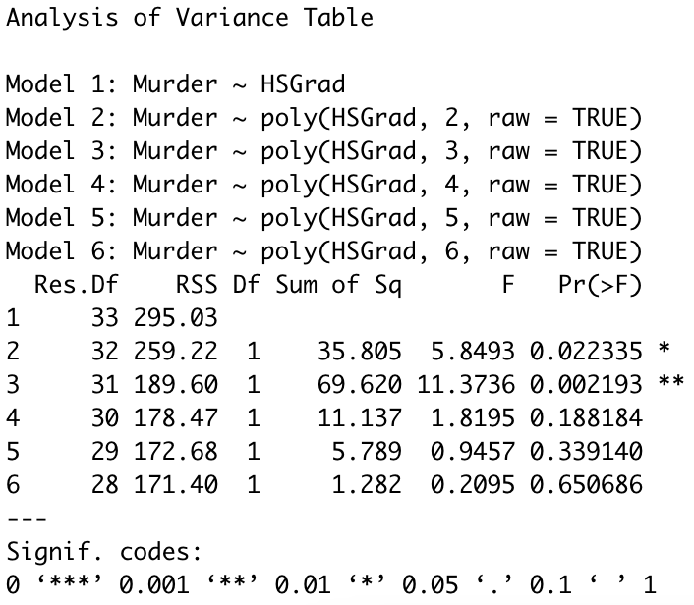
ANOVA Table Analysis
< 0.05 (alpha)
Notes:
megan
An example of how we did analyzed each ANOVA table for how HS grad rate related to a variable, here we are looking at how hs grad rate raised to various powers

Slide 19
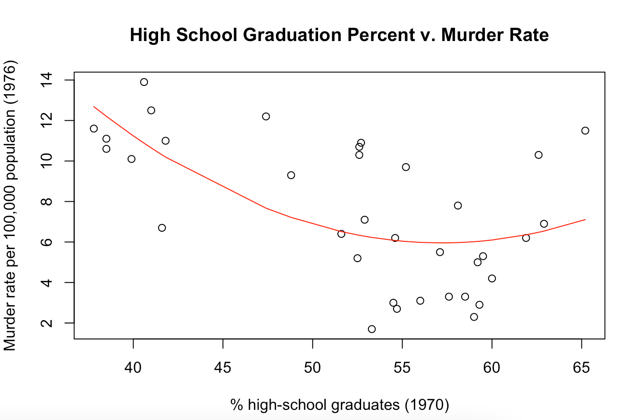
Models Generated
*Data points in graph are from training data set
Notes:
Megan
Power of 2

Slide 20
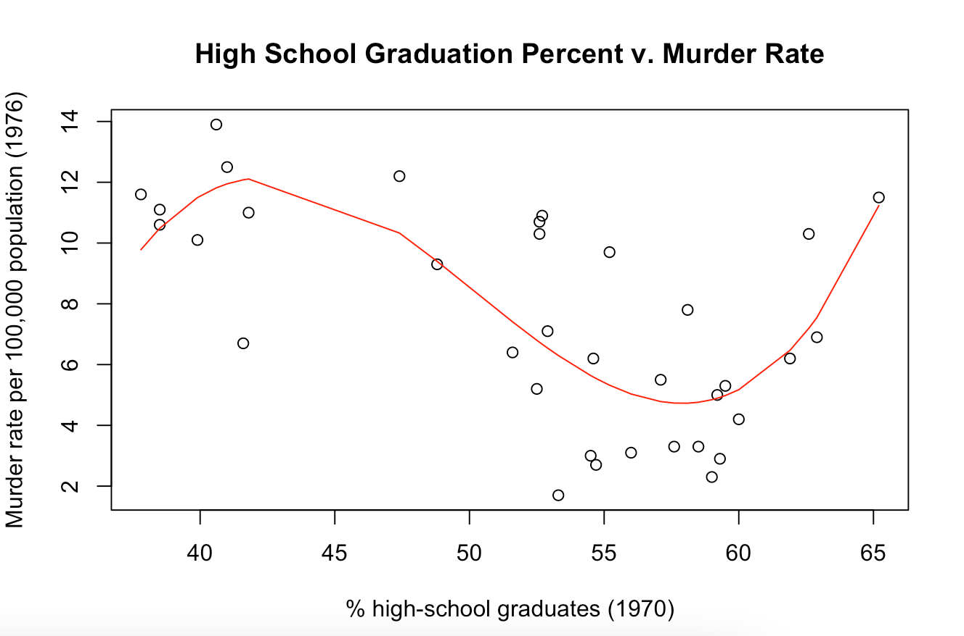
Models Generated
*Data points in graph are from training data set
Notes:
megan
Power of 2

Slide 21
03
Linear Regression with Interaction Terms

Slide 22
PROCESS
Used “summary” to determine the R-squared
Determined which variables to use as the interaction terms
1
2
3
4
Created the plot and trendline of that model
Ran the testing data through the model to get the MSE

Slide 23
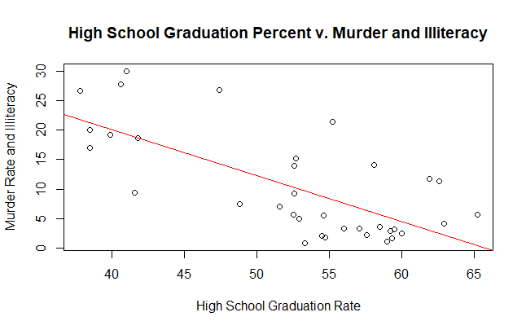
Models Generated
*Data points in graph are from training data set
Notes:
Power of 5

Slide 24
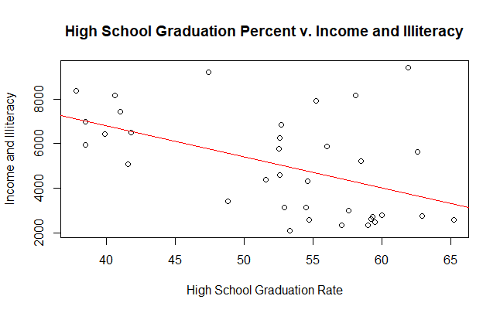
Models Generated
*Data points in graph are from training data set
Notes:
Power of 5

Slide 25
04
Results

Slide 26
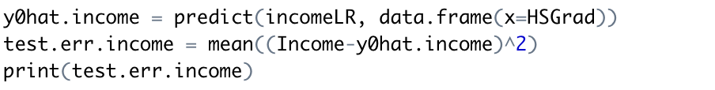
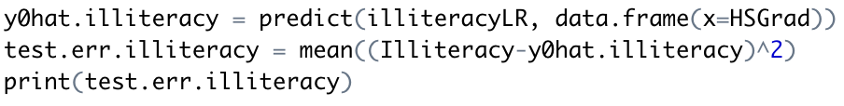
Testing Error - Income
Testing Error - Illiteracy
Income = 47.600(HSGrad) + 1834.360
Illiteracy = -0.049951(HSGrad) + 3.823143
MSE =
361388.6
MSE =
0.2149918
R Code:
R Code:

Slide 27
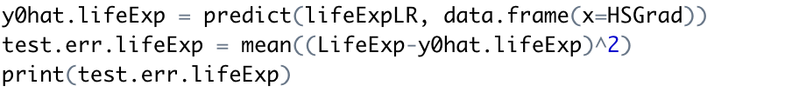
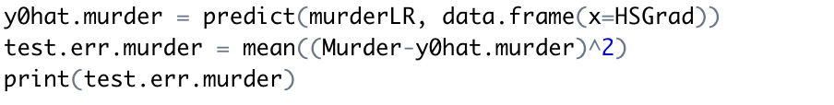
Testing Error - LifeEx
Testing Error - Murder
LifeExp = 0.10147(HSGrad) + 65.45780
Murder = -0.24502(HSGrad) + 20.32405
MSE =
1.493826
MSE =
14.36564
R Code:
R Code:

Slide 28
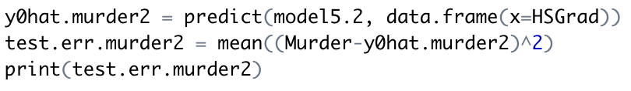
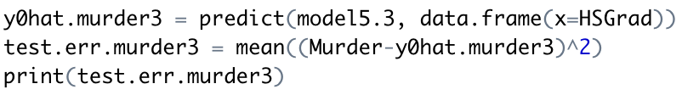
Testing Error - Murder (^2)
Testing Error - Murder (^3)
Murder = 64.493253 - 2.047240(HSGrad) + 0.017900(HSGrad^2)
Murder = 156.4- 9.357(HSGrad) + 0.1836(HSGrad^2) + 0.001184(HSGrad^3)
MSE =
11.48441
MSE =
22.46635
R Code:
R Code:
Notes:
megan

Slide 29
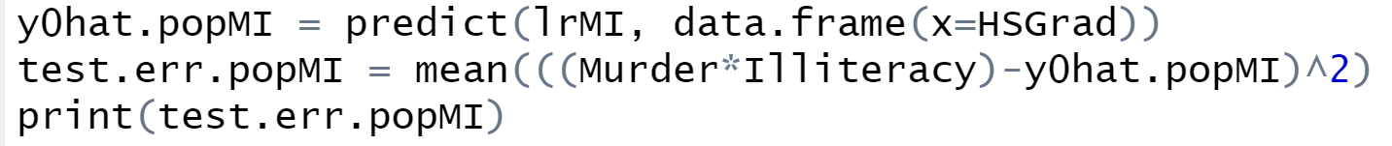
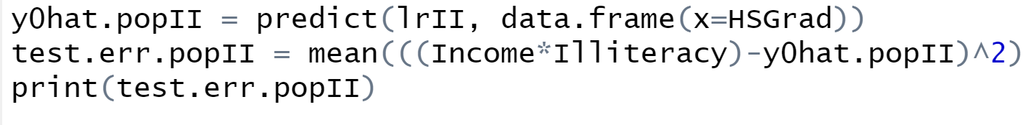
Testing Error - Murder and Illiteracy
Testing Error - Income and Illiteracy
Murder and Illiteracy = -.777(HSGrad)+51.196
Income and Illiteracy = -139.26(HSGrad) +12360.85
MSE =
78.59103
MSE =
4214909
R Code:
R Code:

Slide 30
Conclusions

Slide 31
Conclusions - Discoveries
We’ve discovered that as High School Graduation rate increased…
The Income rate increased linearly
The Life Expectancy increased linearly
The Murder rate decreased linearly
The Illiteracy rate decreased linearly
We also learned that there was no direct relationship between the HS Graduation Rate and the Population of a state from the initial correlation test performed

Slide 32
Conclusions - Attempted Approaches
Approaches
Linear Regression
Polynomial Regression
Linear Regression with Interaction Terms
Worked very well for certain variables and the models were very representative of the data
Worked well when model was to the power of 2, but otherwise other polynomial models were overfitting with small training data set
Worked for certain combinations of variables but wasn’t very representative of the data overall

Slide 33
Conclusions - Best Approach
Overall, for most of the variables, linear regression was the best approach used as it was simple to use and understand, didn’t overfit the data, and had relatively low MSE
Although polynomial regression created a better model for HS Graduation Rate v. Murder Rate, the MSE was only slightly better than the linear model
More data points would be necessary to better determine the type of relationship that best fit the Murder Rate data

Slide 34
Thank you!
Questions?

